Slide 1
Week 4 Presentation
11107014
林冠良

Slide 2
SPI
A synchronous serial communication interface specification used for short-distance communication.

Slide 3
Serial Peripheral Interface
A four-wire serial bus
A synchronous serial interface
Full duplex mode
Master-slave architecture

Slide 4
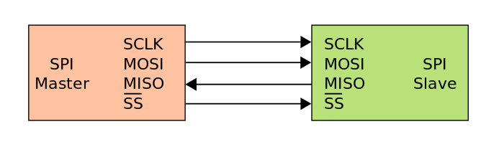
4 Logic Signals
SCLK
Serial Clock (output from master)
MOSI
Master Out Slave In (data output from master)
MISO
Master In Slave Out (data output from slave)
CS /SS
Chip/Slave Select (often active low, output from master to indicate that data is being sent)

Slide 5
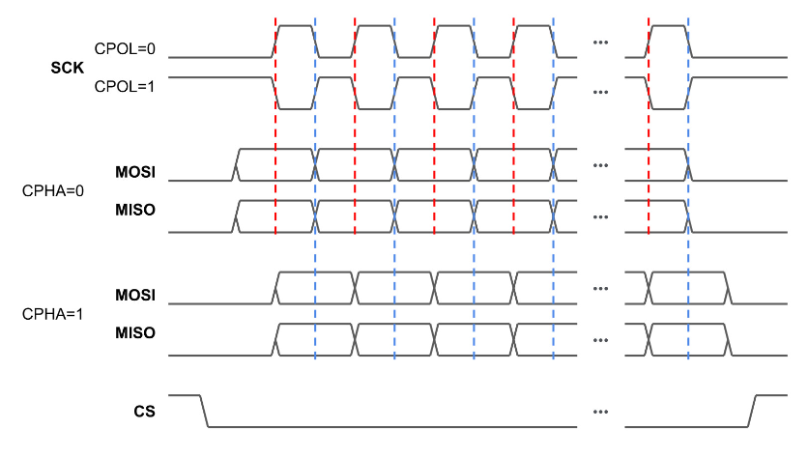
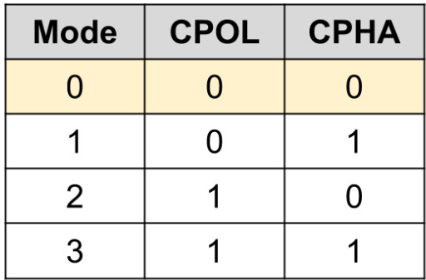
SPI Modes

Slide 6
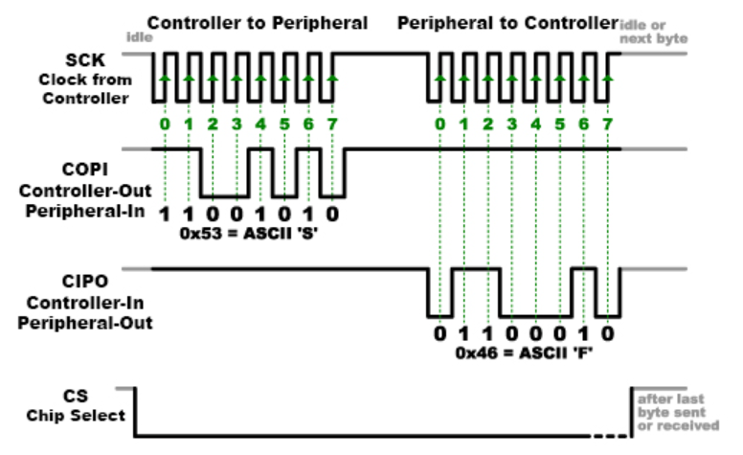
Data Transmission
The master outputs the clock signal.
The master switches the SS/CS pin to a low voltage state, which activates the slave.
The master switches the SS/CS pin to a low voltage state, which activates the slave.
If a response is needed, the slave returns data one bit at a time to the master along the MISO line. The master reads the bits as they are received.

Slide 7
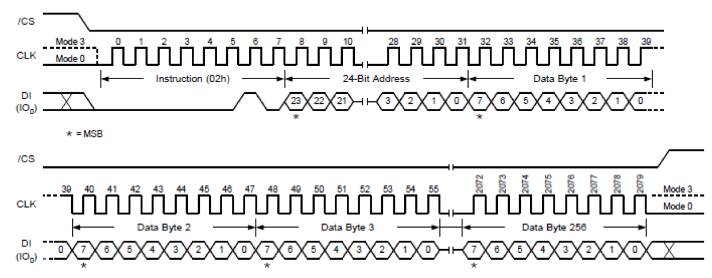
Timing Diagram (Page program)

Slide 8
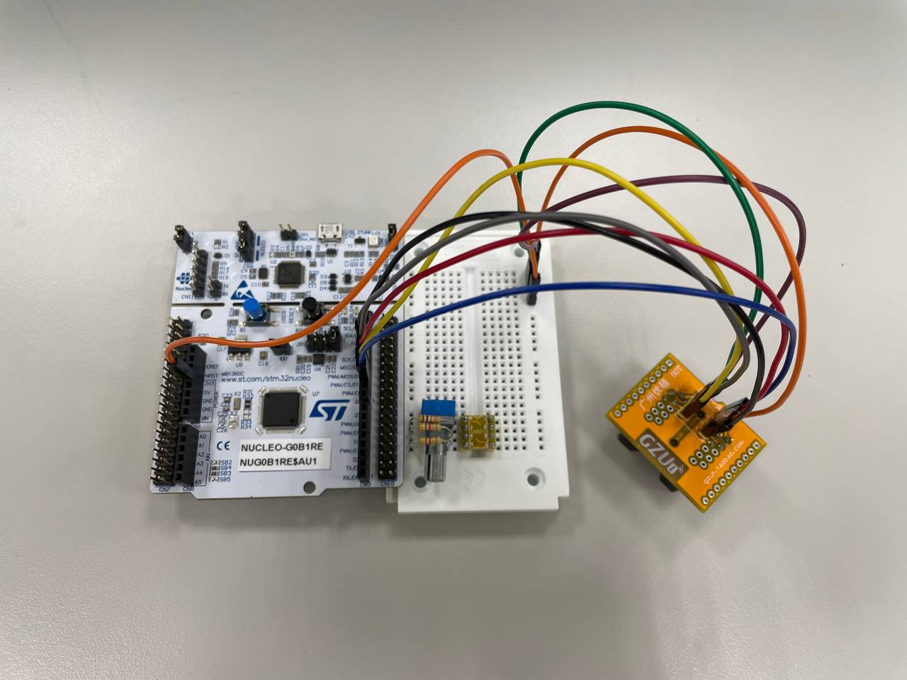
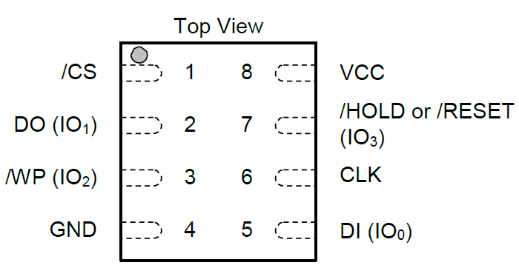
Circuit
/WP, /HOLD and VCC connected to 3V3 in series.
GND on flash connected to GND on board.
CLK connected to SCK(D13).
DO connected to MISO(D12).
DI connected to MOSI(D11).
/CS connected to CD(D10).
Horizontally opposite!

Slide 9
Coding
SPI_Flash

Slide 10
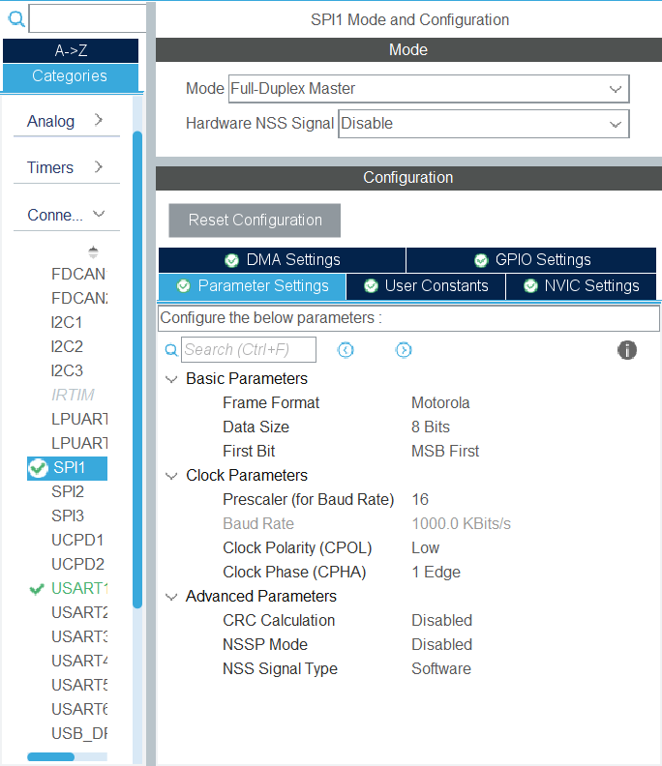
Enable SPI
Enable SPI1
Mode: Full-Duplex Master
Data Size: 8 bits
First Bit: MSB First
Clock Polarity(CPOL): Low
Clock Phase(CPHA): 1 edge

Slide 11
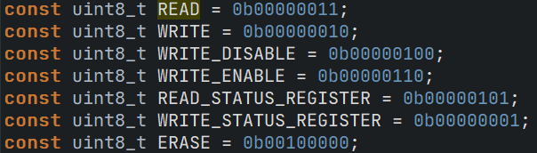
Set Instruction Constants

Slide 12
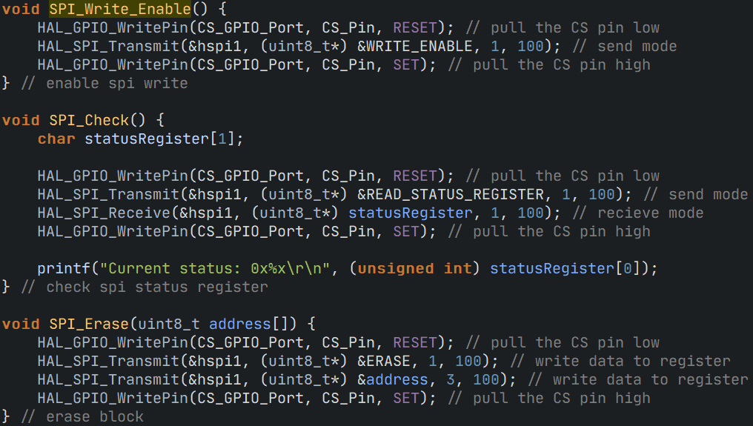
Functions

Slide 13
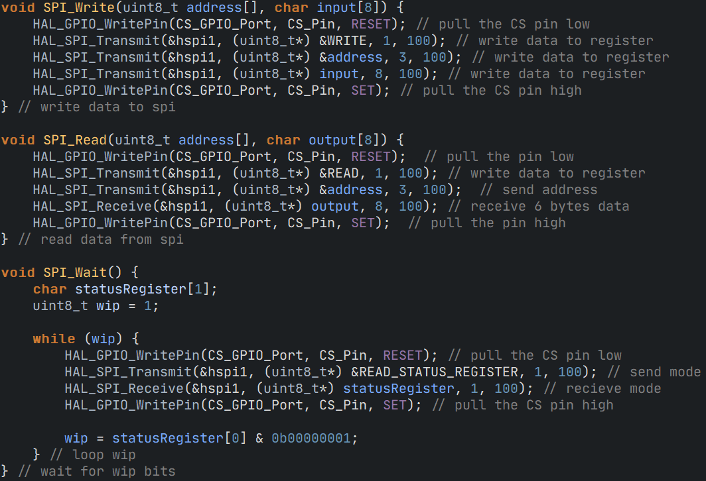
Functions

Slide 14
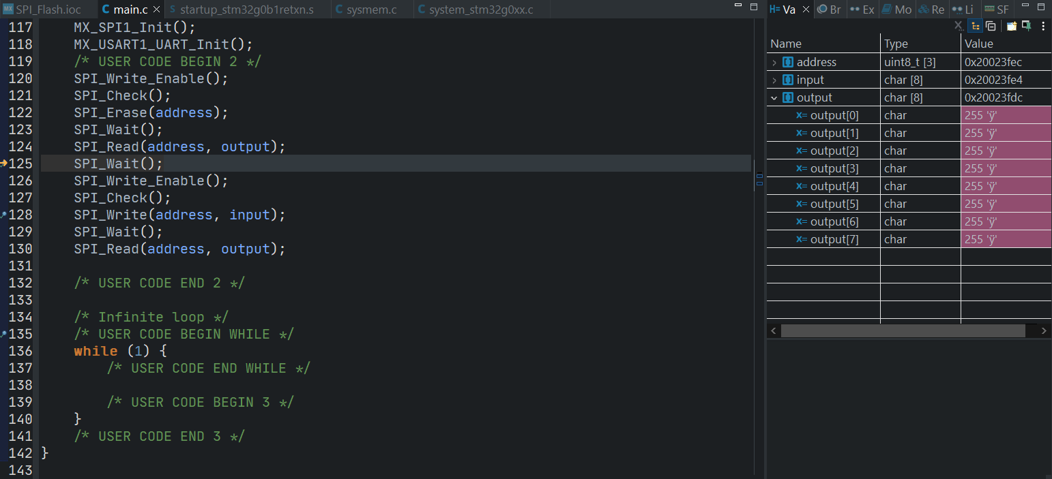
Results - Erase and Read

Slide 15
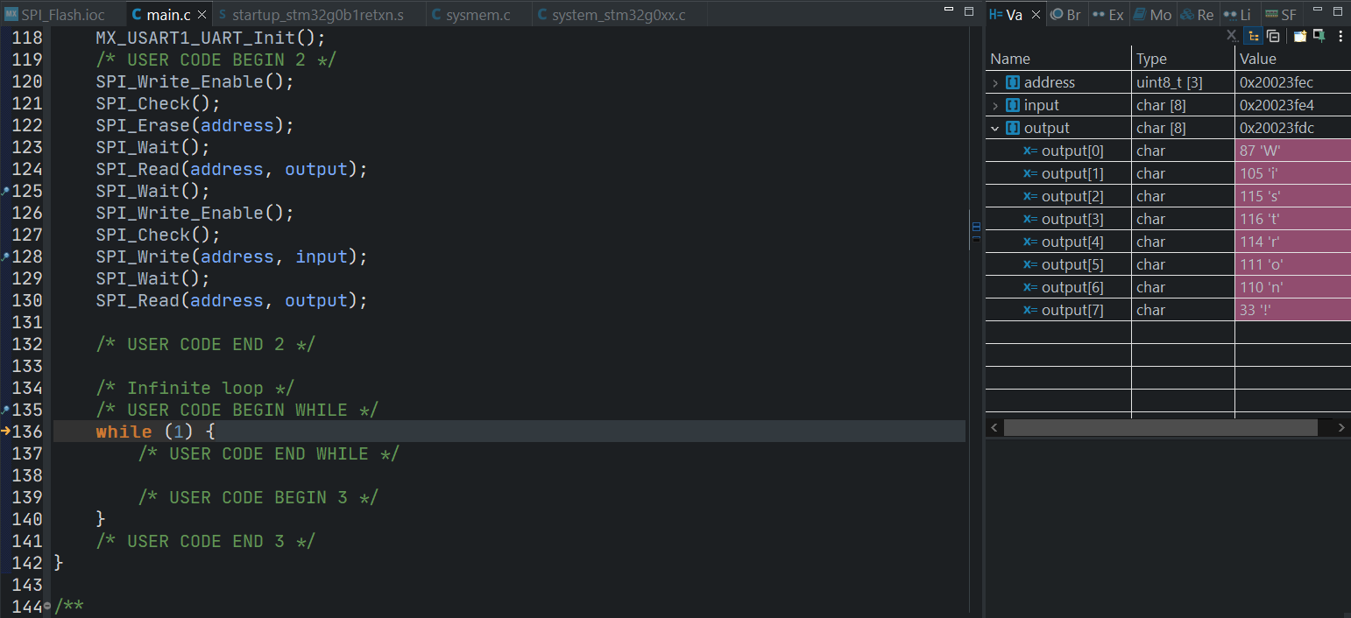
Results - Write and Read again

Slide 16

Thank you for your listening
林冠良
Noah_Lin@wistron.com
https://github.com/popshia

